Slide 1
Software metrics to Predict the health of a project?
Vincent Blondeau

Slide 2
Context
Industrial PhD in a major international IT company
7 300 employees
17 countries
Problems from the field

Slide 3
Context
Agile Artifacts
Bugs
Recommendations / Alerts to improve the project
Social Network
Dev Process
Project leaders
Doc
Tool
Source code
Developers
Production metrics
Continuous integration
Architects
Notes:
Big data

Slide 4
Overview
Data mining
Literature survey
Meeting with team managers

Slide 5
Data mining
Agile Artifacts
Bugs
Recommendations / Alerts to improve the project
Social Network
Dev Process
Project leaders
Doc
Tool
Source code
Developers
Production metrics
Continuous integration
Architects
Notes:
Big data

Slide 6



Project data mining
Extracted from Excel files
Bugs: qualification / acceptance / prod
Budgets: projects and intermediate releases
Notes:
ACP + corrélations sous R

Slide 7
Exploitable data
20 projects (out of 43)
300 bugs / project on average
1400 Men*Days / project on average
60 intermediate releases (out of 725)
600 Men*Days / release on average
92 bugs / release on average

Slide 8
Project data mining
Bugs
Critical, major, minor,
Qualification, acceptance, production
Budget
Predicted, Realized
Delta Predicted / Realized
Slippage
Yes / No
Number of months

Slide 9
Project data mining
Bugs
Critical, major, minor,
Qualification, acceptance, production
Budget
Predicted, Realized
Delta Predicted / Realized
Slippage
Yes / No
Number of months
Project Name Length

Slide 10
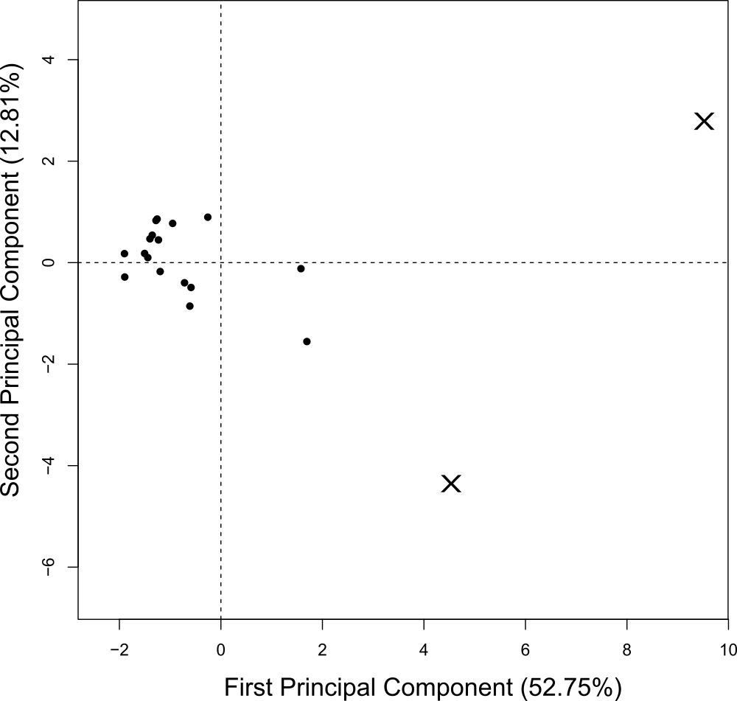
Projects metrics correlation
Notes:
expliquer

Slide 11
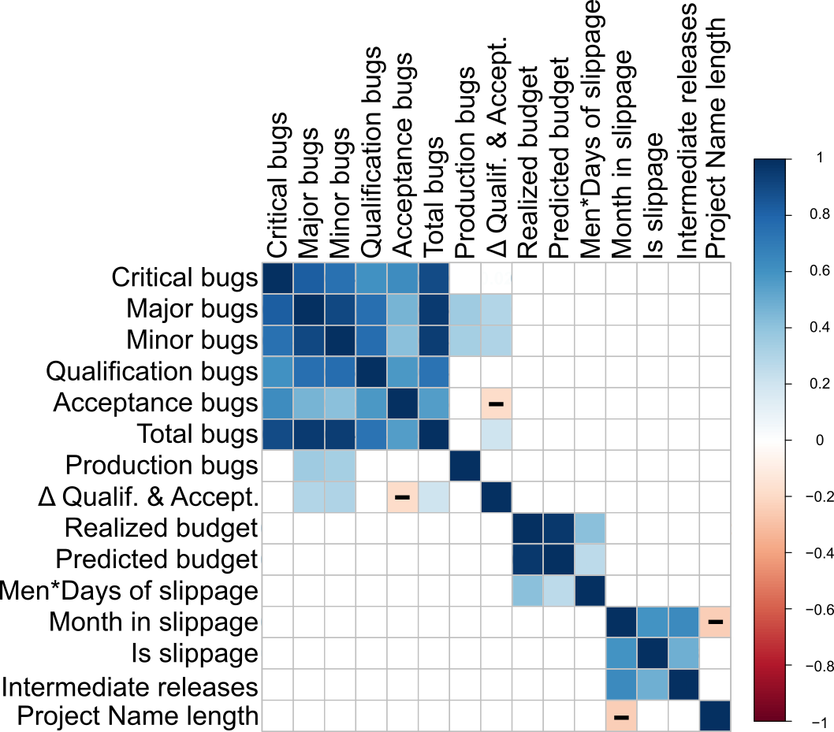
Projects metrics correlation
Correlation method:
Spearman
Notes:
Spearman car non distribution normale -> tests non paramétriques (resultats moins clairs)
Important -> foncé
Donner exemple

Slide 12
Projects metrics correlation
Correlation method:
Spearman
Bugs
Budget
Slippage
Notes:
Spearman car non distribution normale -> tests non paramétriques (resultats moins clairs)
Important -> foncé
Donner exemple

Slide 13
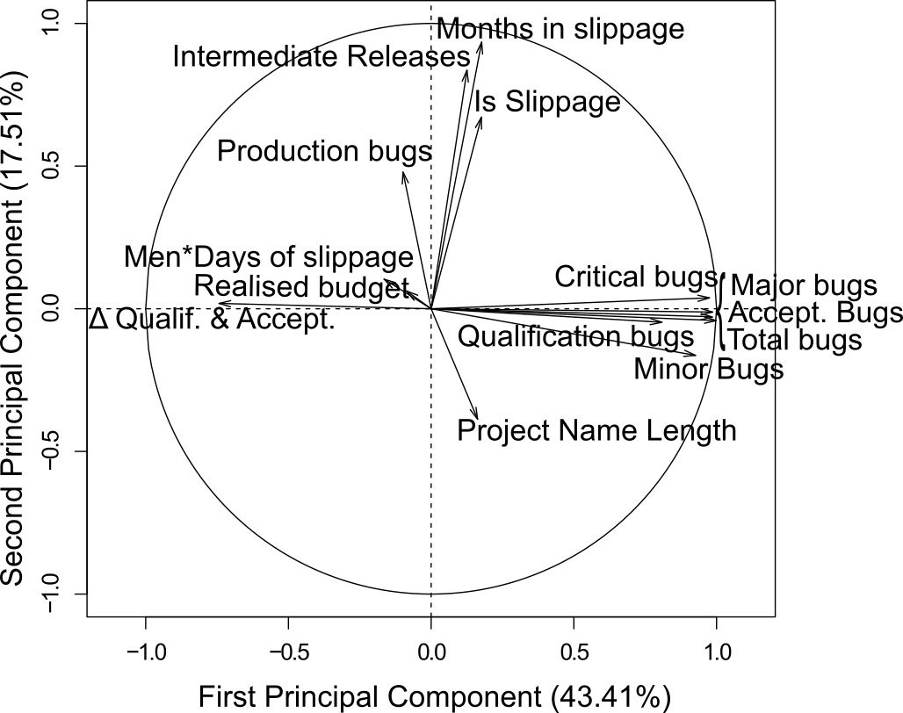
Projects metrics correlation
Notes:
En rouge le dérapage en vert les bugs et le budget

Slide 14
Projects metrics correlation
Notes:
En rouge le dérapage en vert les bugs et le budget

Slide 15
Data mining results
Bugs ⇒ Bugs
Slippage ⇏ Bugs
Bugs ⇏ Slippage
Production Bugs ⇒ Slippage
Name length ⇒ Less bugs

Slide 16
Overview
Data mining
Literature survey
Meeting with team managers

Slide 17
Literature survey
Agile Artifacts
Bugs
Recommendations / Alerts to improve the project
Social Network
Dev Process
Project leaders
Doc
Tool
Source code
Developers
Production metrics
Continuous integration
Architects
Notes:
Big data

Slide 18
Mining Metrics to Predict Component Failures Nachiappan Nagappan, Thomas Ball, Andreas Zeller 2006, ICSE
Goal: Predict after release bugs
5 C++ Microsoft projects
18 source code metrics
Correlations, PCA, regression models
∃ some metrics correlated to bugs
∄ metrics for all the projects
The prediction seems accurate on the same kind of project
Notes:
(IE6, IIS W3 Server Core, process Messaging component, DirectX, NetMeeting)

Slide 19
A model to predict anti-regressive effort in Open Source Software Andrea Capiluppi, Juan Fernández-Ramil 2007, ICSM
Goal: Find metrics to identify regressions
8 C/C++ Open Source Systems (OSS)
4 source code metrics
∄ factor which alone makes a best predictor
Each system needs to determine individually which measurement is best
Notes:
Nombre de releases avec changements
Taille
Cyclomatic complexity
FanIn / FanOut
“There is not a single complexity factor which alone makes a best predictor.”

Slide 20
Exploring the relationship between cumulative change and complexity in an Open Source system Andrea Capiluppi, Alvaro E. Faria, Juan F. Ramil - 2005, CSMR
Goal: Find classes to refactor
62 releases of ARLA (AFS file system)
4 code source metrics
50% of classes with frequent changes are the more complex and have the higher number of methods
Notes:
Nombre de livraisons par fichier
Taille
Cyclomatic complexity (somme et moyenne)
FanIn / FanOut

Slide 21
Cross-project defect prediction A Large Scale Experiment on Data vs. Domain vs. Process Thomas Zimmermann, Nachiappan Nagappan – 2009, ESEC/FSE
Goal: predict defects
28 releases of open and closed source software
40 project and source code metrics
OSS ⇒ closed source (CS)
OSS, CS ⇏ OSS
CS₁ ⇒ CS₂ or CS₁ ⇏ CS₂
21 out of 622 (3,4%) cross-project predictions worked
“There was no single factor that led to success”
Notes:
NLOC, bugs, commits, domaine, société, produit, revue de code, vérification automatique de code, langage utilisé, nombre de développeurs,…

Slide 22
Literature review results
Individually, ∃ metrics to make predictions
No unique metric for all the projects
Predictions at posteriori

Slide 23
Overview
Data mining
Literature survey
Meeting with team managers

Slide 24
Meeting with team managers
3 in Retail team
1 in Telecoms team
What are their problems?
How they detect them?
How they resolve them?

Slide 25
Roots Causes of bad health of a project
Delay at the start of the project
Collaboration between the team and the client
Lack of team cohesion
Bad understanding of the specifications
Bad knowledge of the functional concepts
Change of the framework during the development
Experience with the used frameworks
Bypass the qualification tests
High number of bugs listed by the client

Slide 26
Conclusion
Literature survey
No correlation
Data mining
No correlation
Wrong metrics studied at first

Slide 27
Conclusion
Literature survey
No correlation
Data mining
No correlation
Wrong metrics studied at first
Next step: Survey to validate these root causes Help to test software

